Slide 1


Analog Electronics Fundamentals 102
-Capacitors
-Inductors
-Diodes, LEDs
-Relays
-Alternating Current (AC)
-Breadboards
-Lab1: Simple Breadboard Circuit
-Lab2: Relay, LED, Pushbutton
-Lab3: RC Circuit with LED

Slide 2
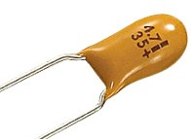
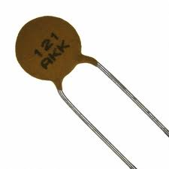
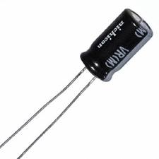
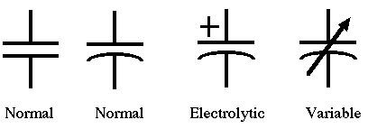
1 Capacitors
A capacitor (the old-fashioned name was condenser) is a device that has two wires sticking out of it and has the following property: Q = CV
A capacitor of C farads (unit: F) with V volts across its terminals has Q coulombs of stored charge.
Popular Capacitor Types are: Electrolytic Metal Can(Polarized), Ceramic (Non-Polarized) and Tantalum (Polarized)
**Excerpt taken from: The Art of Electronics by Paul Horowitz

Slide 3
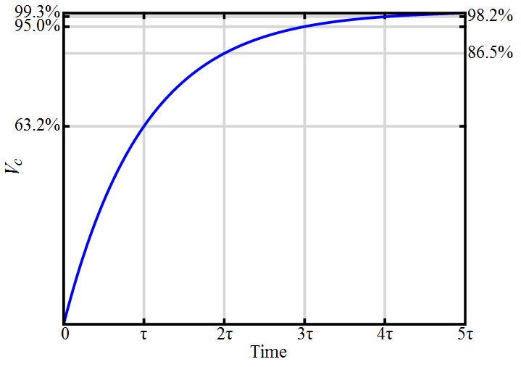
1.1 RC Circuits
RC Circuit is the name give to a circuit that has a capacitor and a resistor. There are many applications for RC Circuits, however we will only timing and delay applications here.
t = RC

Slide 4
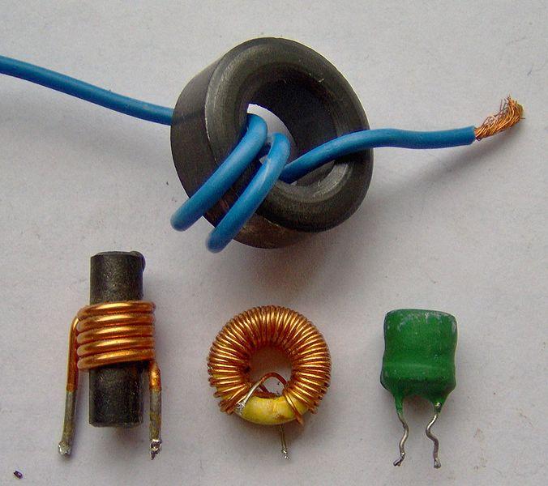
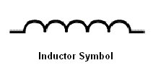
2 Inductors
An inductor (also choke, coil or reactor) is a passive two-terminal electrical component that stores energy in its magnetic field. For comparison, a capacitor stores energy in an electric field, and a resistor does not store energy but rather dissipates energy as heat.
Any conductor has inductance although the conductor is typically wound in loops to reinforce the magnetic field.
Due to the time-varying magnetic field inside the coil, a voltage is induced, according to Faraday's law of electromagnetic induction, which by Lenz's law opposes the change in current that created it. Inductors are one of the basic components used in electronics where current and voltage change with time, due to the ability of inductors to delay and reshape alternating currents.
**Excerpt and picture taken from Wikipedia Article on Inductors.

Slide 5
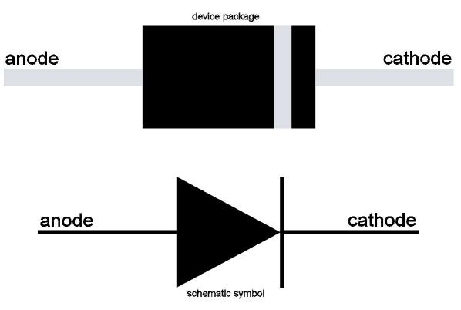
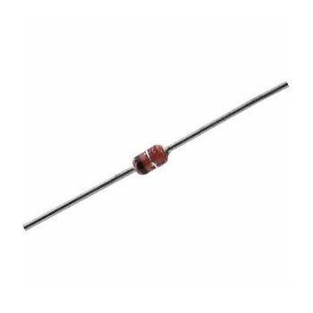
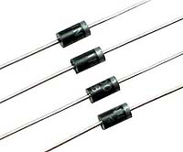
3 Diodes
The circuit elements we've seen so far (resistors, capacitors, and inductors) are all linear, meaning that a doubling of the applied signal (a voltage, say) produces a doubling of the response (a current , say). This is true even for the reactive devices (capacitors and inductors). These devices are also passive, meaning that they don' t have a built-in source of power. And they are all two-terminal devices, which is self explanatory.
The diode is a very important and useful two-terminal passive nonlinear device. The diode’s arrow (the anode terminal) points in the direction of forward current flow (conventional current flow).
**Excerpt taken from: The Art of Electronics by Paul Horowitz

Slide 6
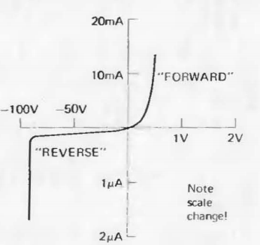
3.1 Diodes – Voltage Drop
If the diode is in a circuit in which a current of 10mA is flowing from anode to cathode, then (from the graph) the anode is approximately 0.5 volt more positive than the cathode; this is called the "forward voltage drop.“
As a rule of thumb, the forward voltage drop of a regular diode will be approximately 0.7 volt.
A frequent use of Diodes of for the Rectification of AC Power.
**Excerpt and Picture taken from:The Art of Electronics by Paul Horowitz

Slide 7
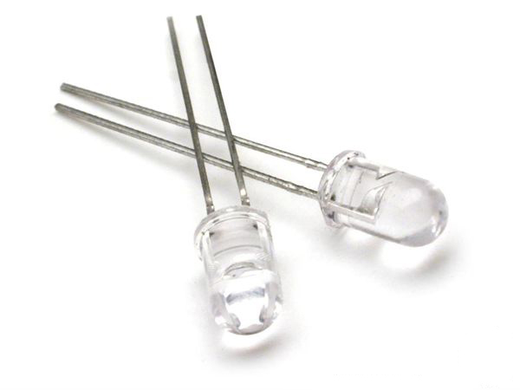
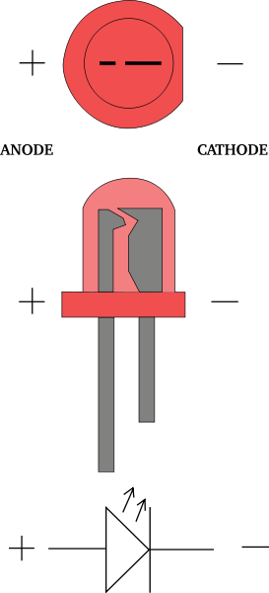
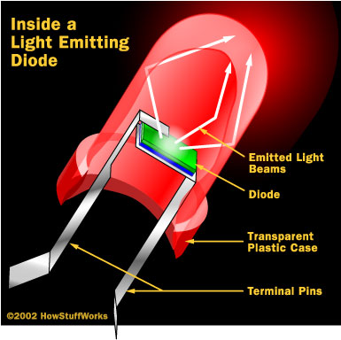
3.2 Light Emitting Diodes (LEDs)
LEDs behave electrically like ordinary diodes, but with a forward voltage drop in the range of 1.5 to 2.5 volts. When current flows in the forward direction, they light up. Typically, 5mA to 20mA produces adequate brightness. LEOs are cheaper than incandescent lamps, they last forever, and they are even available in multiple colors.

Slide 8
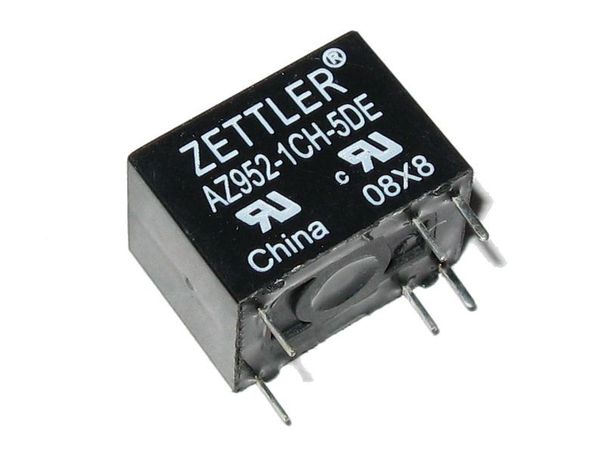
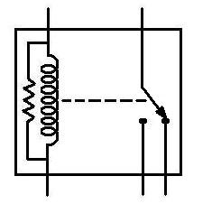
4 Relays
A relay is an electrically operated switch. Many relays use an electromagnet to operate a switching mechanism mechanically, but other operating principles are also used. Relays are used where it is necessary to control a circuit by a low-power signal (with complete electrical isolation between control and controlled circuits), or where several circuits must be controlled by one signal.

Slide 9
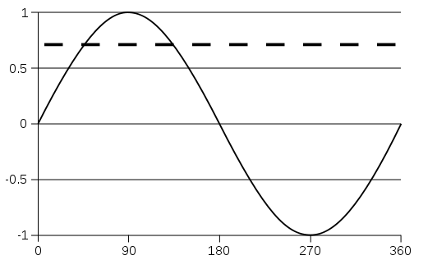
5 Alternating Current (AC)
In alternating current (AC, also ac), the movement of electric charge periodically reverses direction.
AC is the form in which electric power is delivered to businesses and residences. The usual waveform of an AC power circuit is a sine wave. In certain applications, different waveforms are used, such as triangular or square waves. Audio and radio signals carried on electrical wires are also examples of alternating current. In these applications, an important goal is often the recovery of information encoded (or modulated) onto the AC signal.
Below is a sine wave, over one cycle (360°). The dashed line represents the root mean square (RMS) value at about 0.707.
**Excerpt and Picture taken Wikipedia Article on AC current.

Slide 10
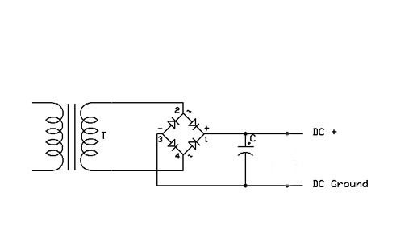
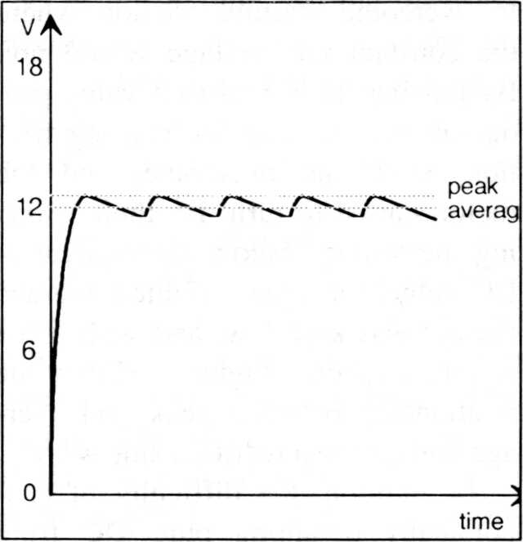
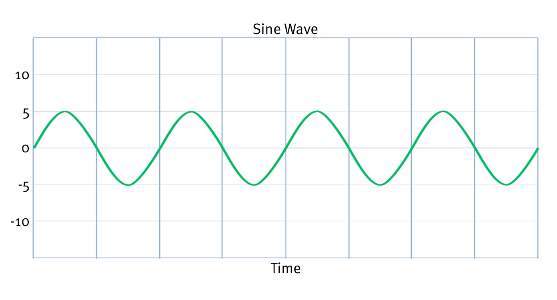
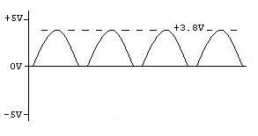
5.1 From AC to DC
The figure bellow illustrates a simple (but very un-efficient) way to create DC from AC, known as a DC Power Supply.

Slide 11
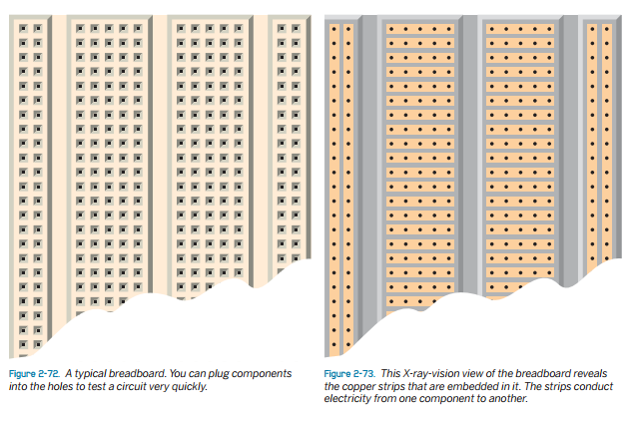
6 Breadboards
For reasons that I do not know, this is called a breadboard. When you plug components into the holes, hidden metal strips inside the breadboard connect the components for you, allowing you to set up a circuit, test it, and modify it very easily. Afterward you can pull the components off the breadboard and put them away for future experiments.
Without a doubt, breadboarding is the most convenient way to test something before you decide whether you want to keep it. Almost all breadboards are designed to be compatible with integrated circuit chips (which we will be using in Chapter 4 of this book). The chip straddles an empty channel in the center of the breadboard with rows of little holes either side—usually five holes per row. You insert other components into these holes.
In addition, the breadboard should have columns of holes running down each side. These are used to distribute positive and negative power
**Excerpt and Picture taken from: Make:Electronics

Slide 12
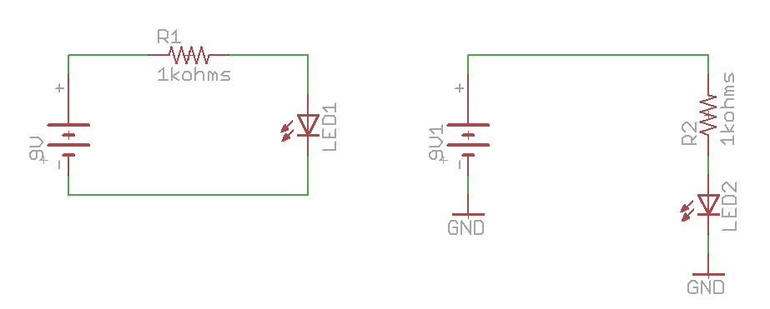
7 Lab1: Simple Breadboard Circuit

Slide 13
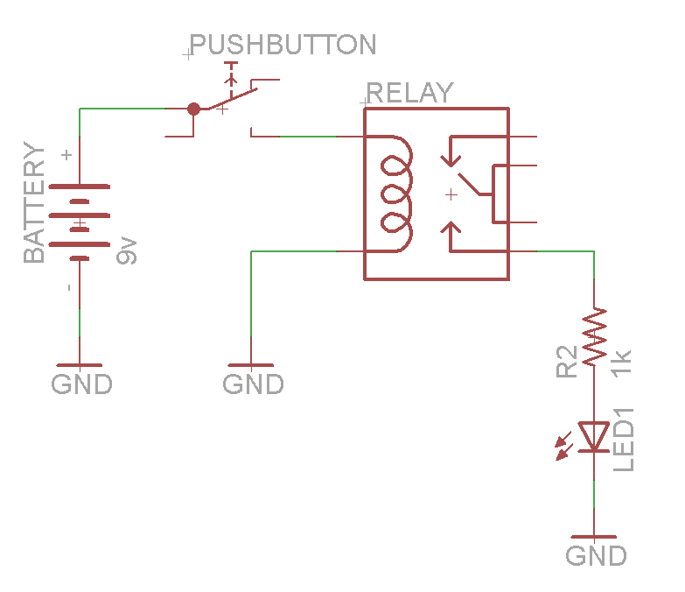
8 Lab2: Relay, LED, Pushbutton

Slide 14
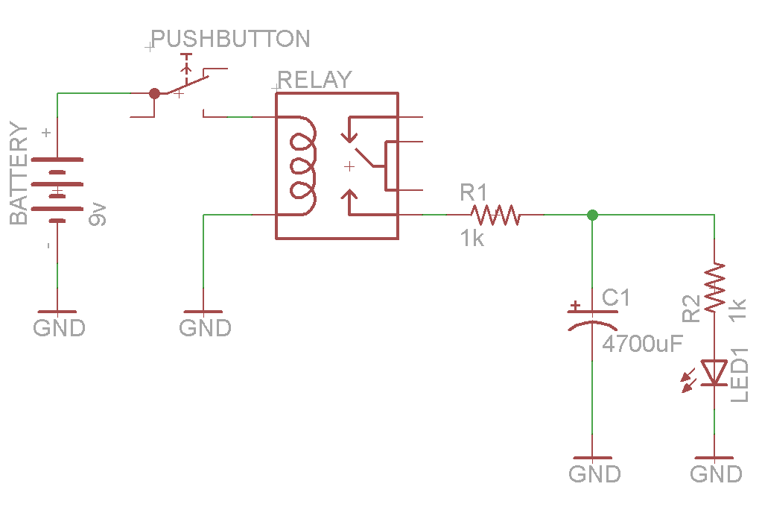
9 Lab3: RC Circuit

